Slide 1



Integrated solution for automation
An Application Specific Full Use (ASFU) license from 2010

Slide 2








Complete analysis & trusted consulting
We pride ourselves in the customers we keep, so we take time to understand our customers complete demands. Thus matching the best software module designed to meet the demands of the specific industry.

Slide 3
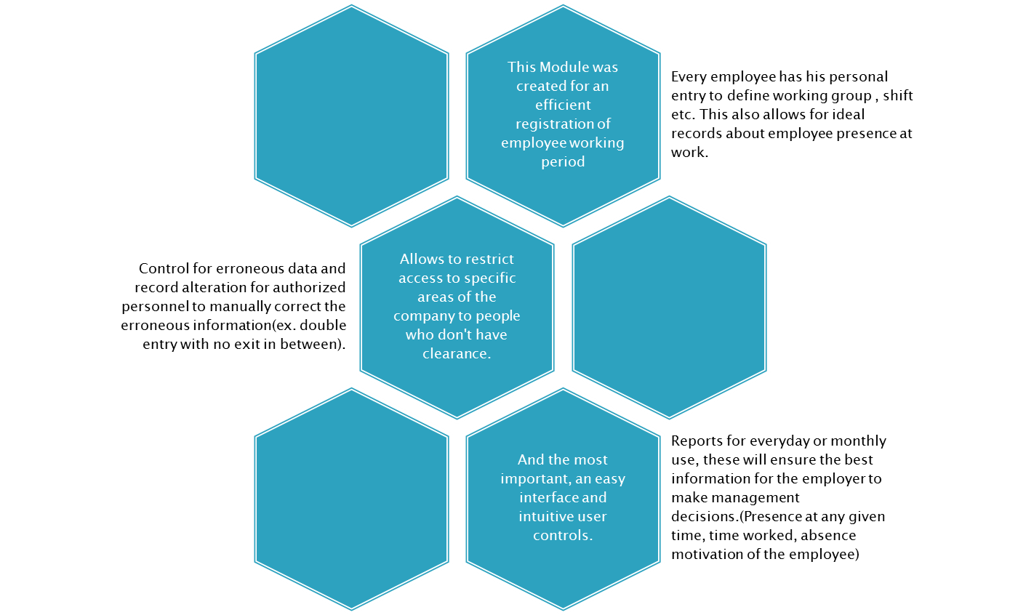
Notes:
diagram

Slide 4
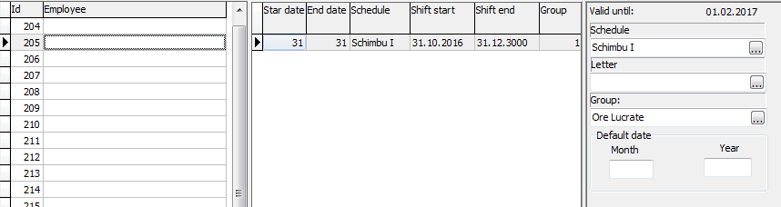
The main forms
Especially designed for fast access to all settings of the access system, schedules, employees work cards (shifts, personal info etc.)
Shift, work groups , period of employment etc.
This will guarantee a well planned and full control of the schedules of each and every worker.

Slide 5
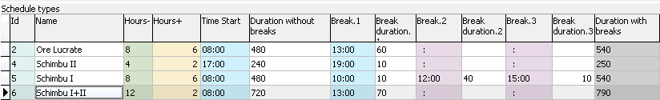
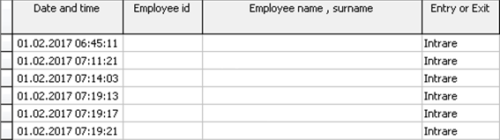
This essential information for any work time calculation has been made as easy to use and allows for an intuitive way to set the total work time, breaks, start and finish to the shifts.

Slide 6
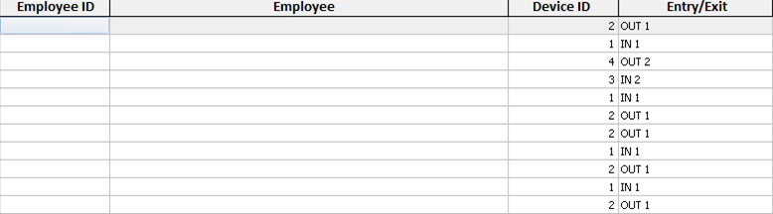
To ensure the security, the access control system is set to allow entry only to authorized personnel.
Since documents don't have a limit in how many there can be there could be created as many as needed and activated when necessary.

Slide 7
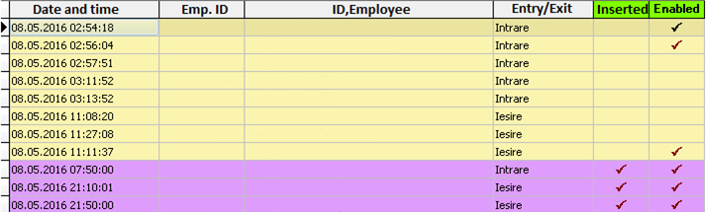
This document allows to list the records for a period of time and then if needed deactivate some entries or even add entries.
Color coding is used to separate records from the access control system and the ones added by the user thus making it easy to notice alterations by users.

Slide 8
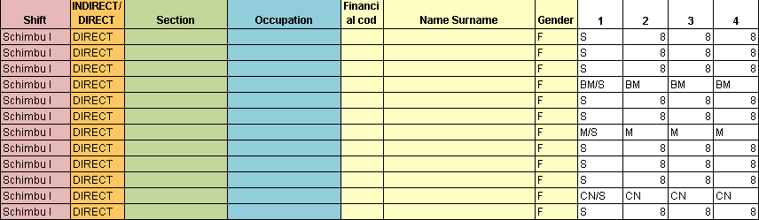
And finally the most important tool at the employer's disposal . The reports were made with the purpose to give the possibility for instantaneous access to data about employee presence at any time on any day or a monthly report(presence ,time worked etc.).
An example of a monthly report. It shows every employee with his job title , work section and more identifying information accompanied by the data for every day (time worked , absence motive etc.)

